Slide 1
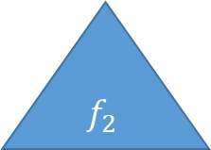
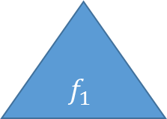
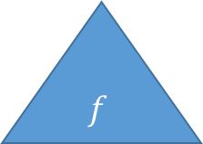

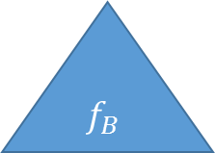
Training Data
Bootstrapped Data 1
Bootstrapped Data 2
Bootstrapped $B$
$$f_{1}$$
$$f_{2}$$
$$f_{B}$$
$$f$$

Slide 2
Training Data
$$f_{1}$$
$$f_{2}$$
$$f_{B}$$
$$f$$

Slide 3
Years<4.5
Yes
No
Hits<117.5
165K
Yes
No
403K
845K

Slide 4
Years<4.5
Yes
No
Hits<117.5
False
Yes
No
False
True

